Slide 1
Machine Learning Foundation Training (Batch 04)
Capstone Project -Sign Classification
Dilshan Gunarathna
DSA_0388

Slide 2
Research approach
Downloaded a database for the sample images of Signs labelling the database accordingly.
Create a model to identify value of the Signs from a dataset consists of the images of various valued traffic sign.
Improve the performance of the model with regard to the following aspects:
Accuracy of the output
Investigate and decide suitable machine learning architectures for the problem.

Slide 3
























Sign classes
Class 1 - 20 sign
Class 6 - 80 sign
Class 4 - 60 sign
Class 2 - 30 sign
Class 7 - 100 sign
Class 5 - 70 sign
Class 3 - 50 sign
Class 8 - 120 sign

Slide 4
Objective
Created data set :
There are 8 classes in the data set that we prepared
To find which of the following categories does a given image belong to:
20 sign
30 sign
50 sign
60 sign
70 sign
80 sign
100 sign
120 sign
We took two approaches towards our classification problem.
From traditional machine learning methods:
Support Vector Machines (SVM)
From deep learning methods:
Convolutional Neural Networks (CNN)

Slide 5
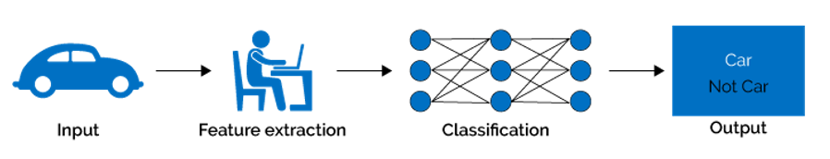
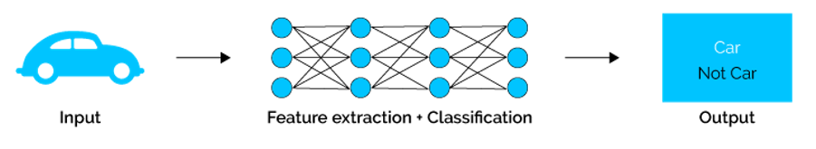
What’s the difference?
Machine Learning
Deep Learning
Needs a lot of domain expertise
Suitable for a smaller data size
Break down the problem and then solve
Less domain expertise needed
Suitable for a large data size
End to end approach in problem solving

Slide 6
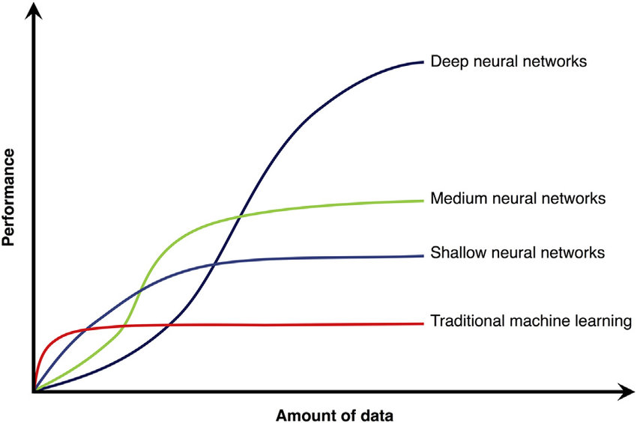
The amount of data affects the performance
Our classification problem

Slide 7
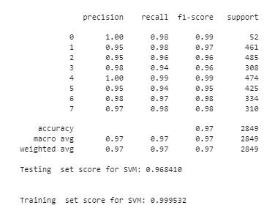
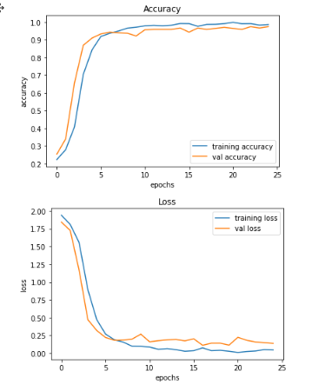
Results obtained from models
SVM Model
CNN Model

Slide 8
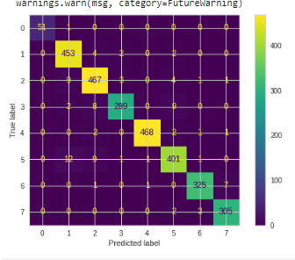
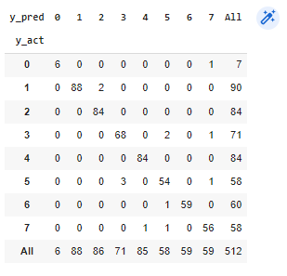
Confusion matrix
SVM Model CNN Model

Slide 9
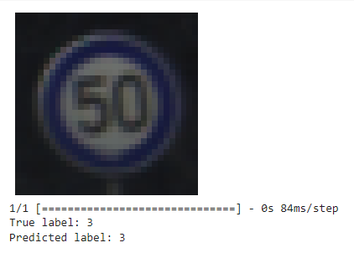
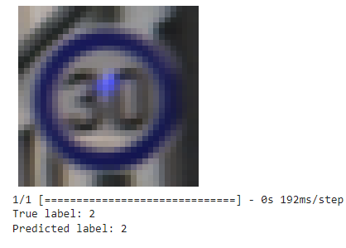
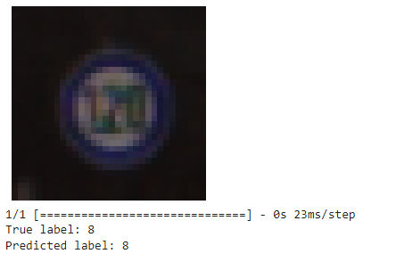
CNN Model - Prediction results

Slide 10
Conclusions
With the SVM model developed using hyperparameter optimization, an accuracy of 99.95%.
The accuracy of the CNN model is 94.67%, the validation accuracy is 98.67%.

